Slide 1


No Idea
Biology project

Slide 2
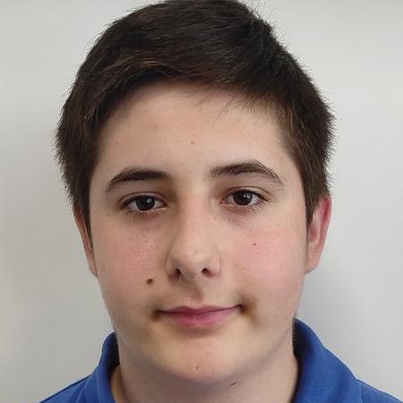
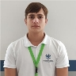
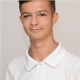
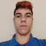
Our team
Ivelin Vasilev
Teodor Osmanliev
Ivaylo Markov
Georgi Milev
Front end developer
Back end developer
Scrum Trainer
QA Engineer

Slide 3

01
Topic Biology
Our project covers 4 main subjects of Biology

Slide 4
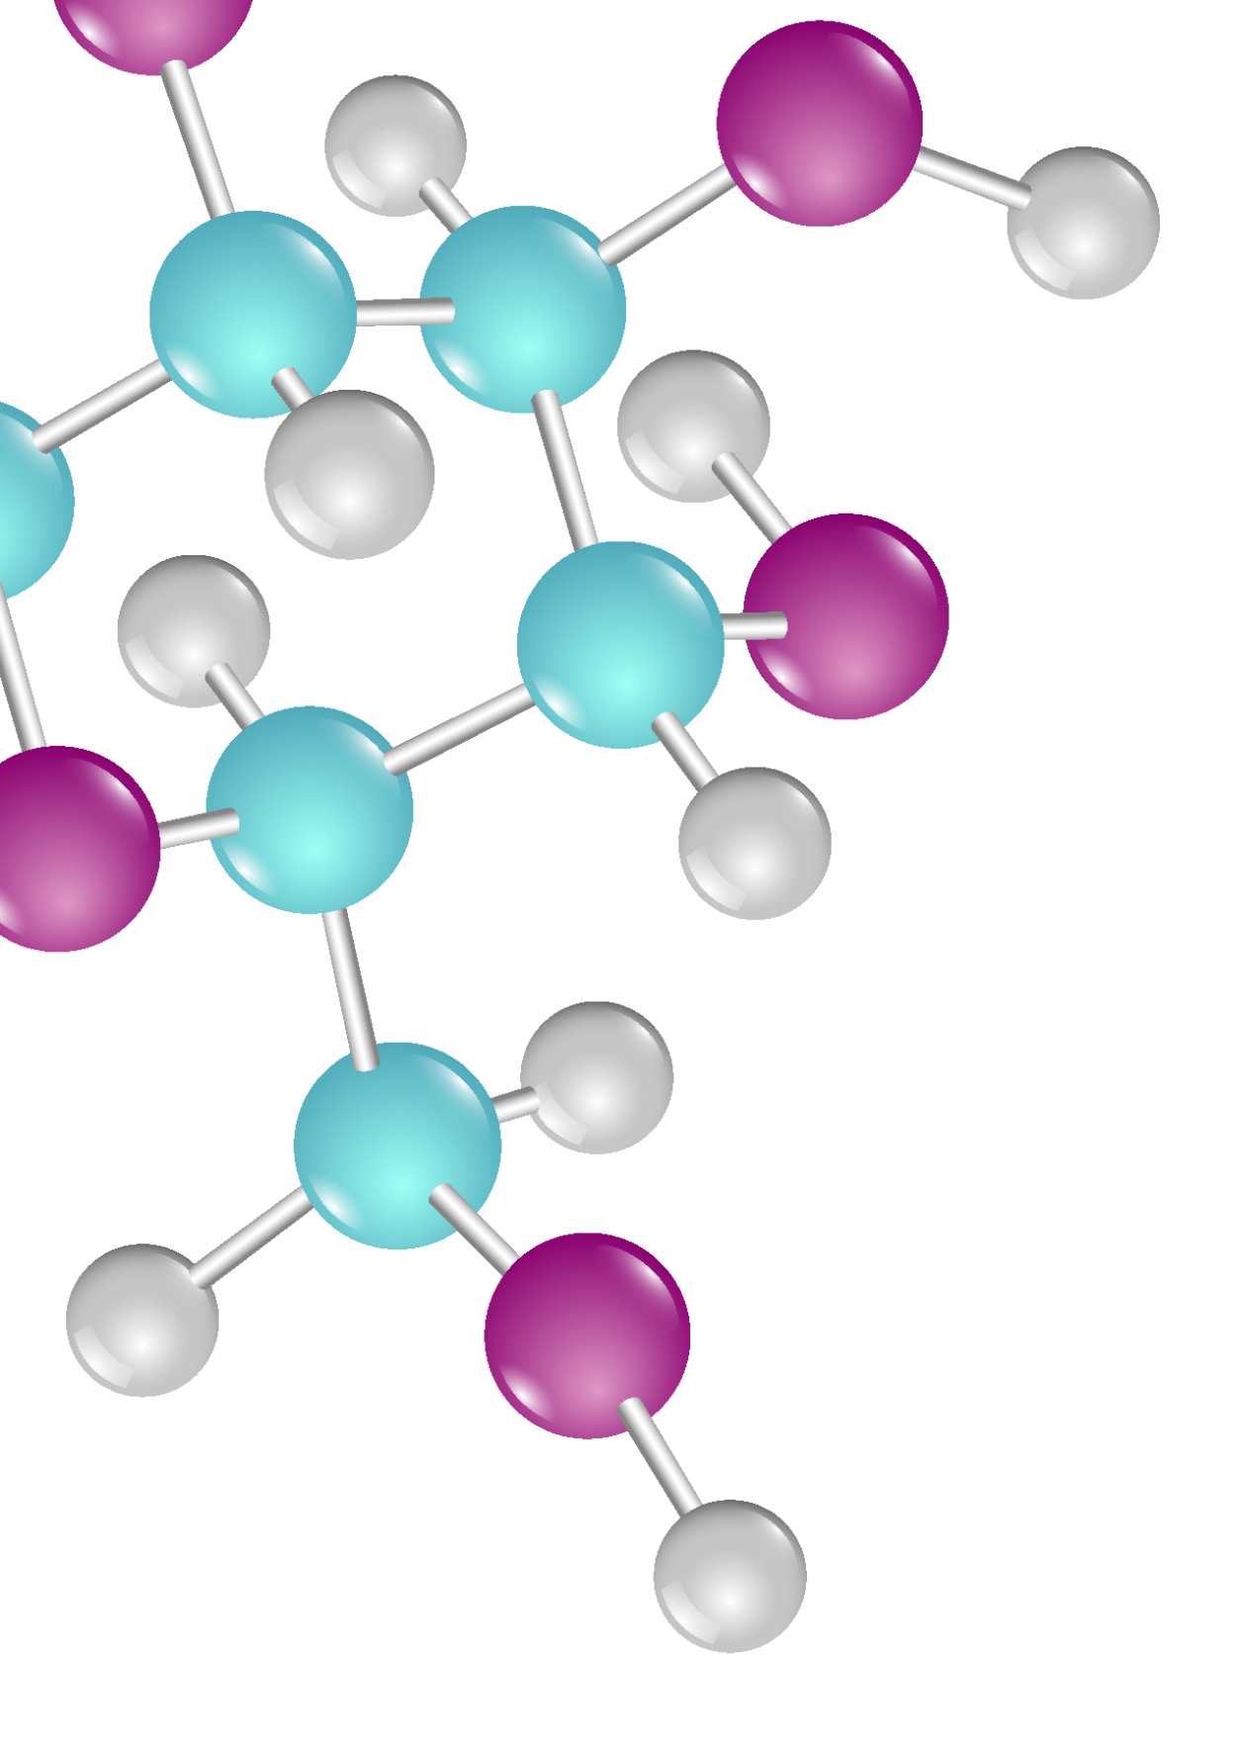
Milestones
2022
ABOUT DNA DAY
We had to go through 5 main stages to realize our project.

Slide 5









Visual Studio
C++
GITHUB
Teams
PHOTOSHOP
WORD
EXCEL
POWERPOINT

Slide 6
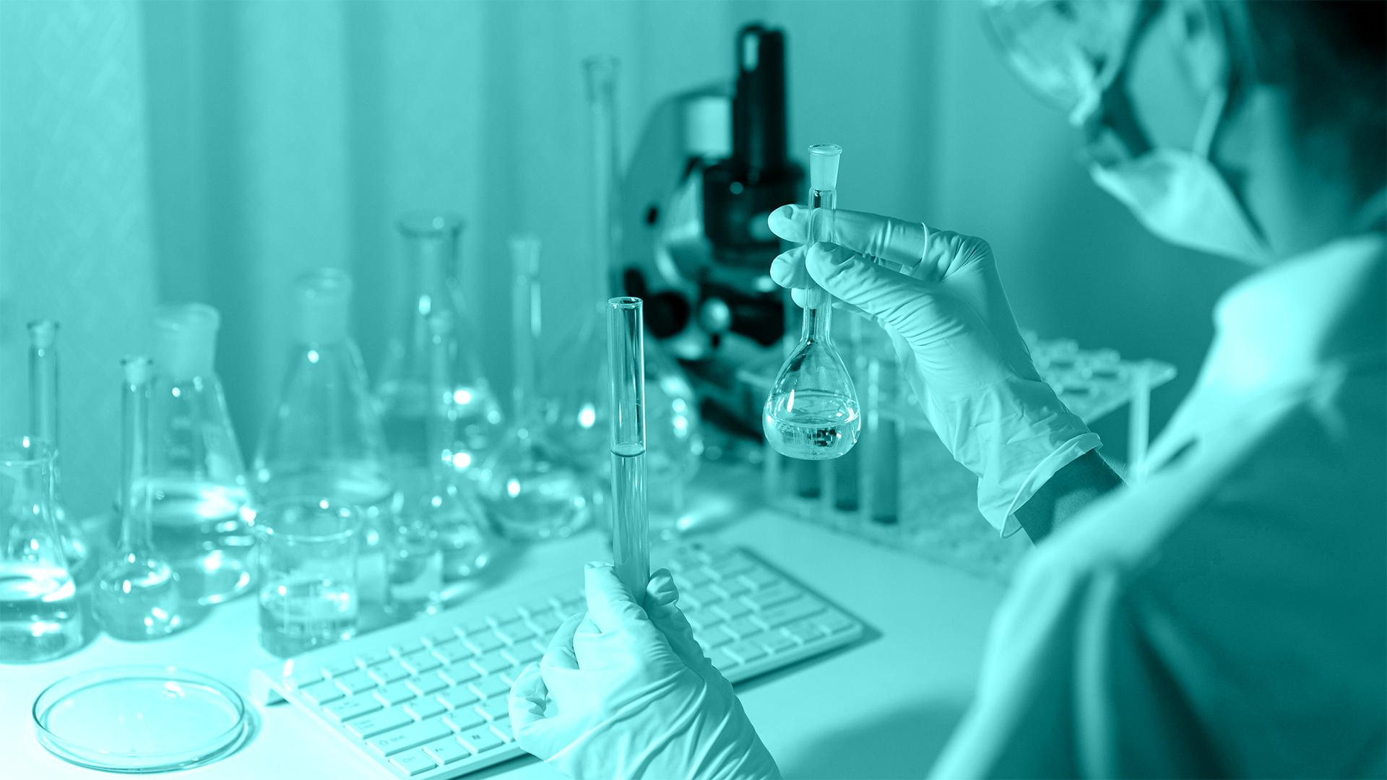
Review of the final product

Slide 7



Thank you for your attention!!!

